Slide 1
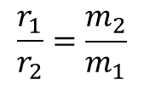
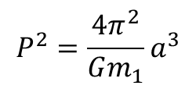
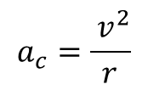
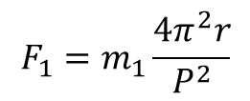
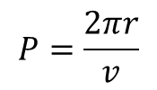
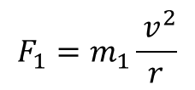
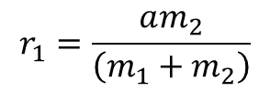
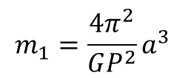
Barycentric Orbits
a
$$a_{c}=\frac{ v^{2}}{r}$$
$$F_{1}=m_{1}\frac{ v^{2}}{r}$$
$$F_{1}=m_{1}a_{c}$$
r₁
r₂
v₂
$$F_{1}=m_{1}\frac{4π^{2}r}{P^{2}}$$
m₁
m₂
$$v^{2}=\frac{{\left(2πr\right)}^{2}}{P^{2}}=\frac{4π^{2}r^{2}}{P^{2}}$$
$$P=\frac{2πr}{v}$$
F₁
F₂
Centre of
Gravity
v₁
$$r_{1}=\frac{am_{2}}{\left(m_{1}+m_{2}\right)}$$
$$\frac{r_{1}}{r_{2}}=\frac{m_{2}}{m_{1}}$$
$$F=G\frac{m_{1}m_{2}}{a^{2}}=F_{1}=m_{1}\frac{4π^{2}r}{P^{2}}$$
$$G\frac{m_{1}m_{2}}{a^{2}}=\frac{4π^{2}m_{1}m_{2}a}{P^{2}\left(m_{1}+m_{2}\right)}$$
$$P^{2}=\frac{4π^{2}}{G\left(m_{1}+m_{2}\right)}a^{3}$$
$$P^{2}=\frac{4π^{2}}{Gm_{1}}a^{3}$$
$$m_{1}=\frac{4π^{2}}{GP^{2}}a^{3}$$

